Slide 1
Black Lives Matter
Brand Responses

Slide 2
Overview
#BLM: a “brand activism” moment
Consumers value actions over messaging
Best practices in brand response
Pitfalls in brand response
Authenticity is critical

Slide 3
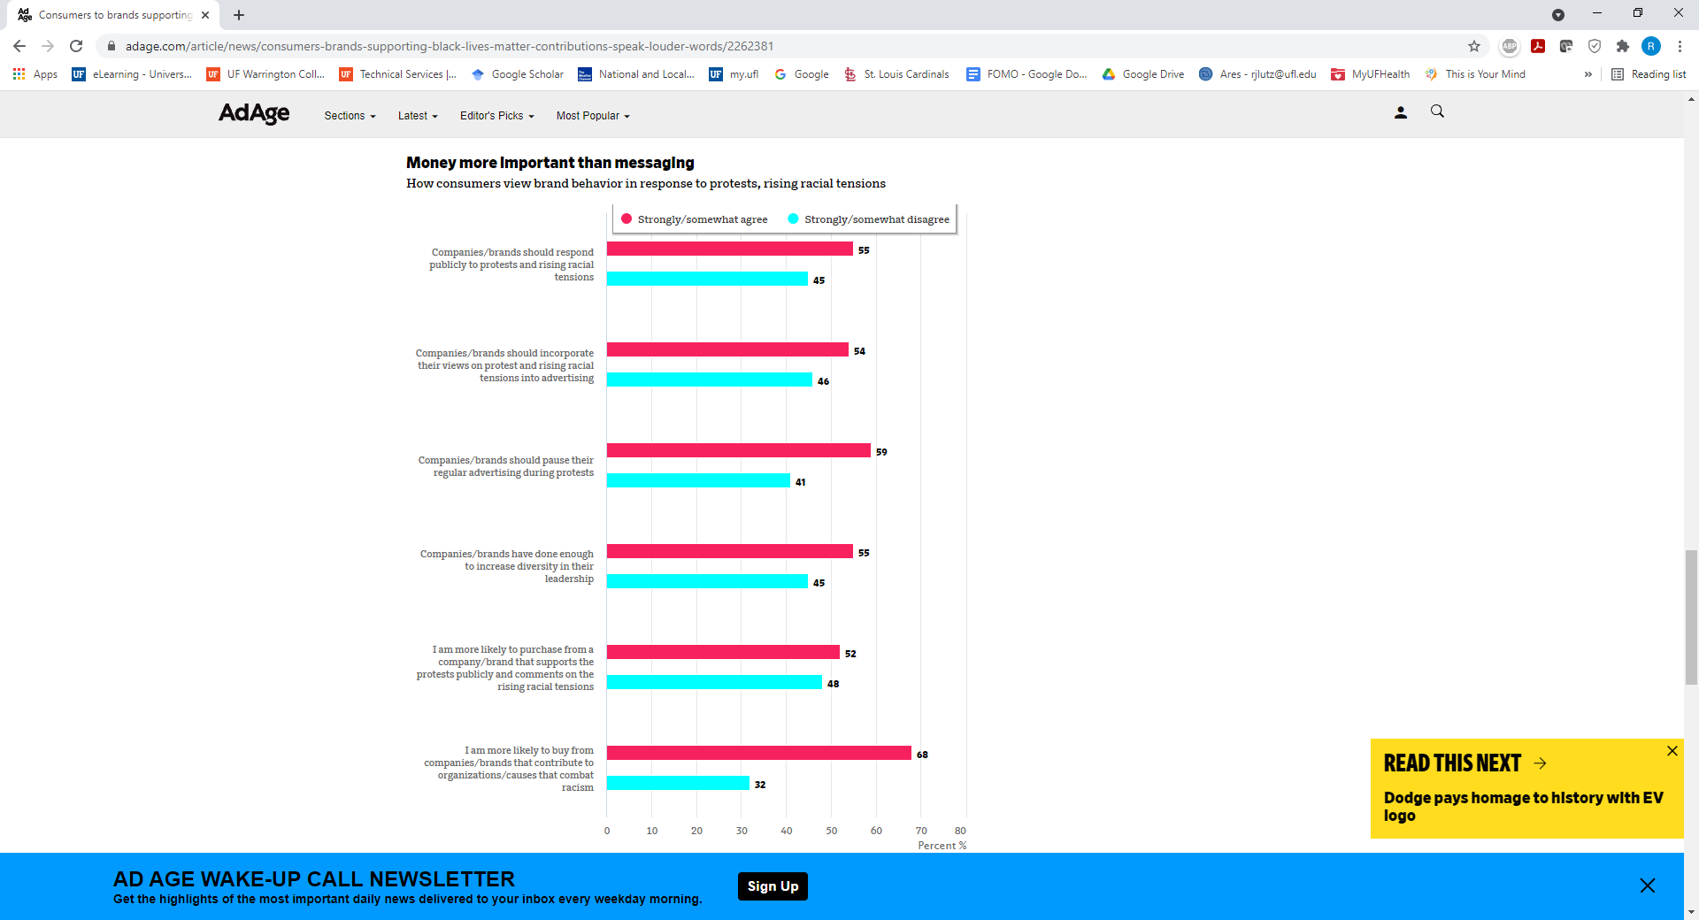
How consumers view brand behavior in response to protests, rising racial tensions

Slide 4
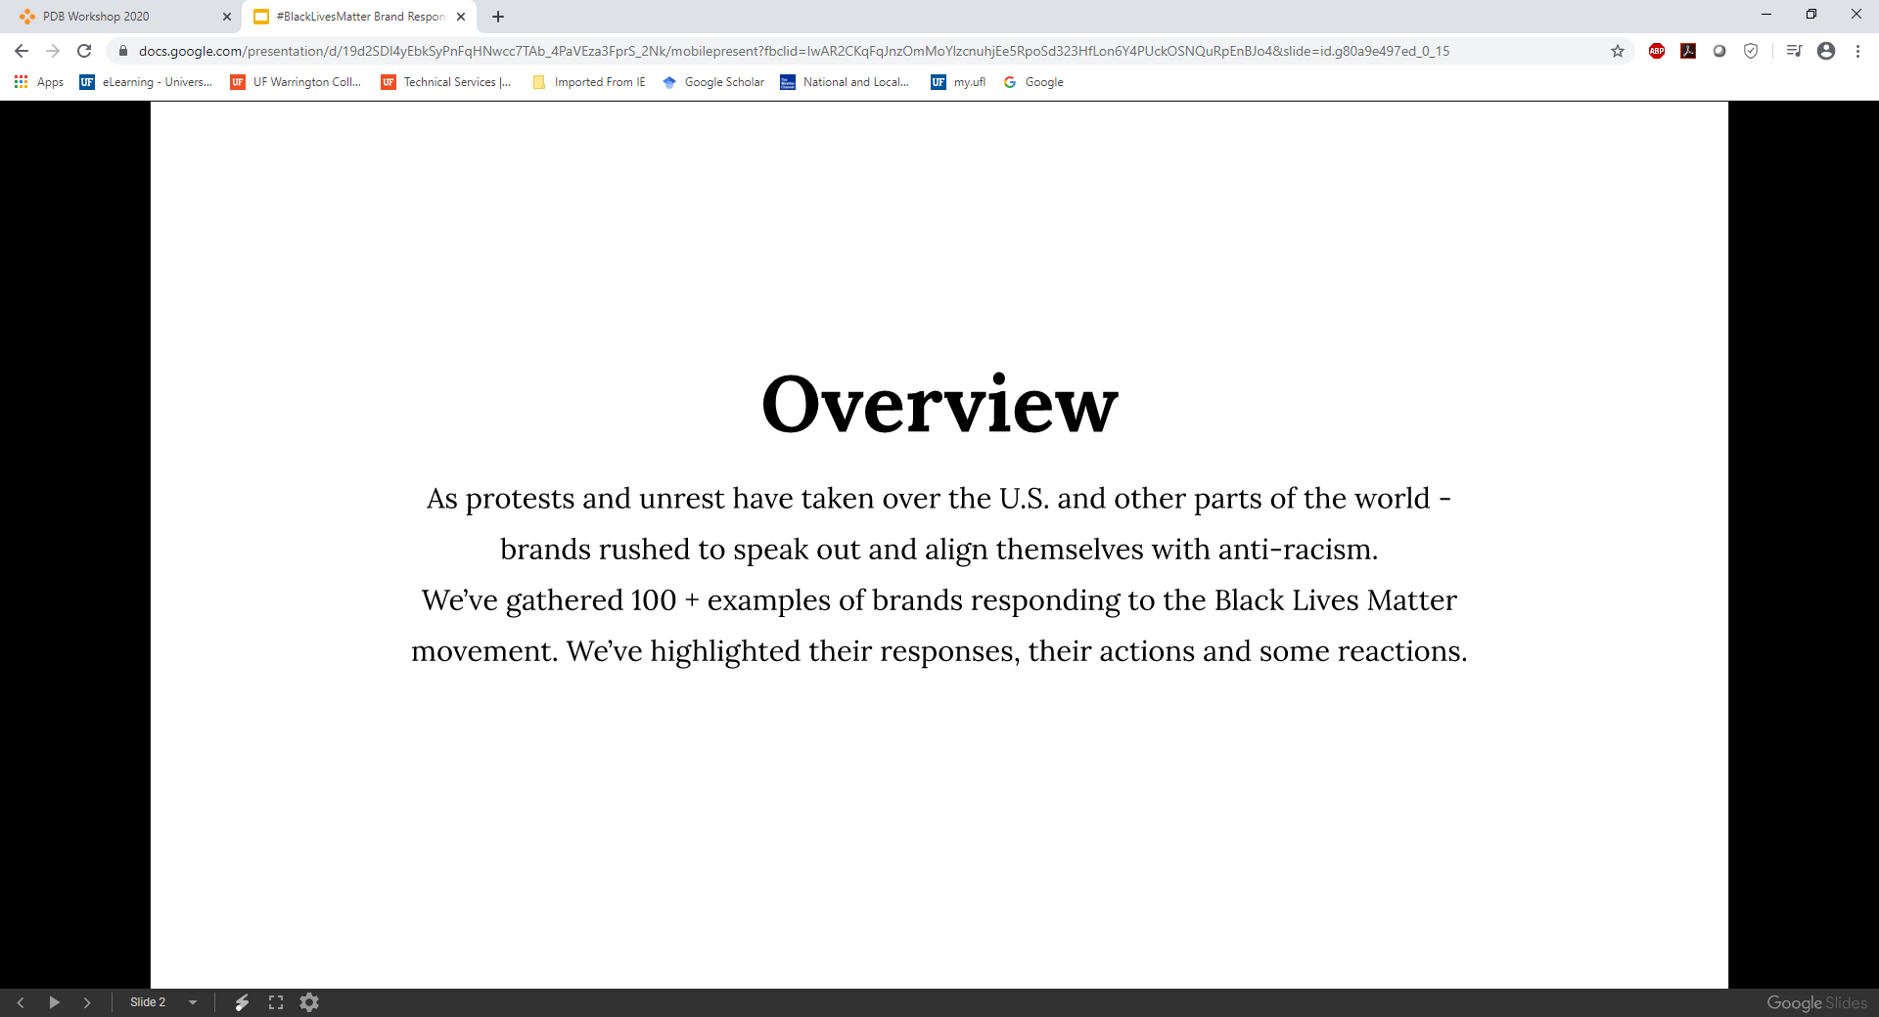
AdAge Study (Summer 2020)

Slide 5
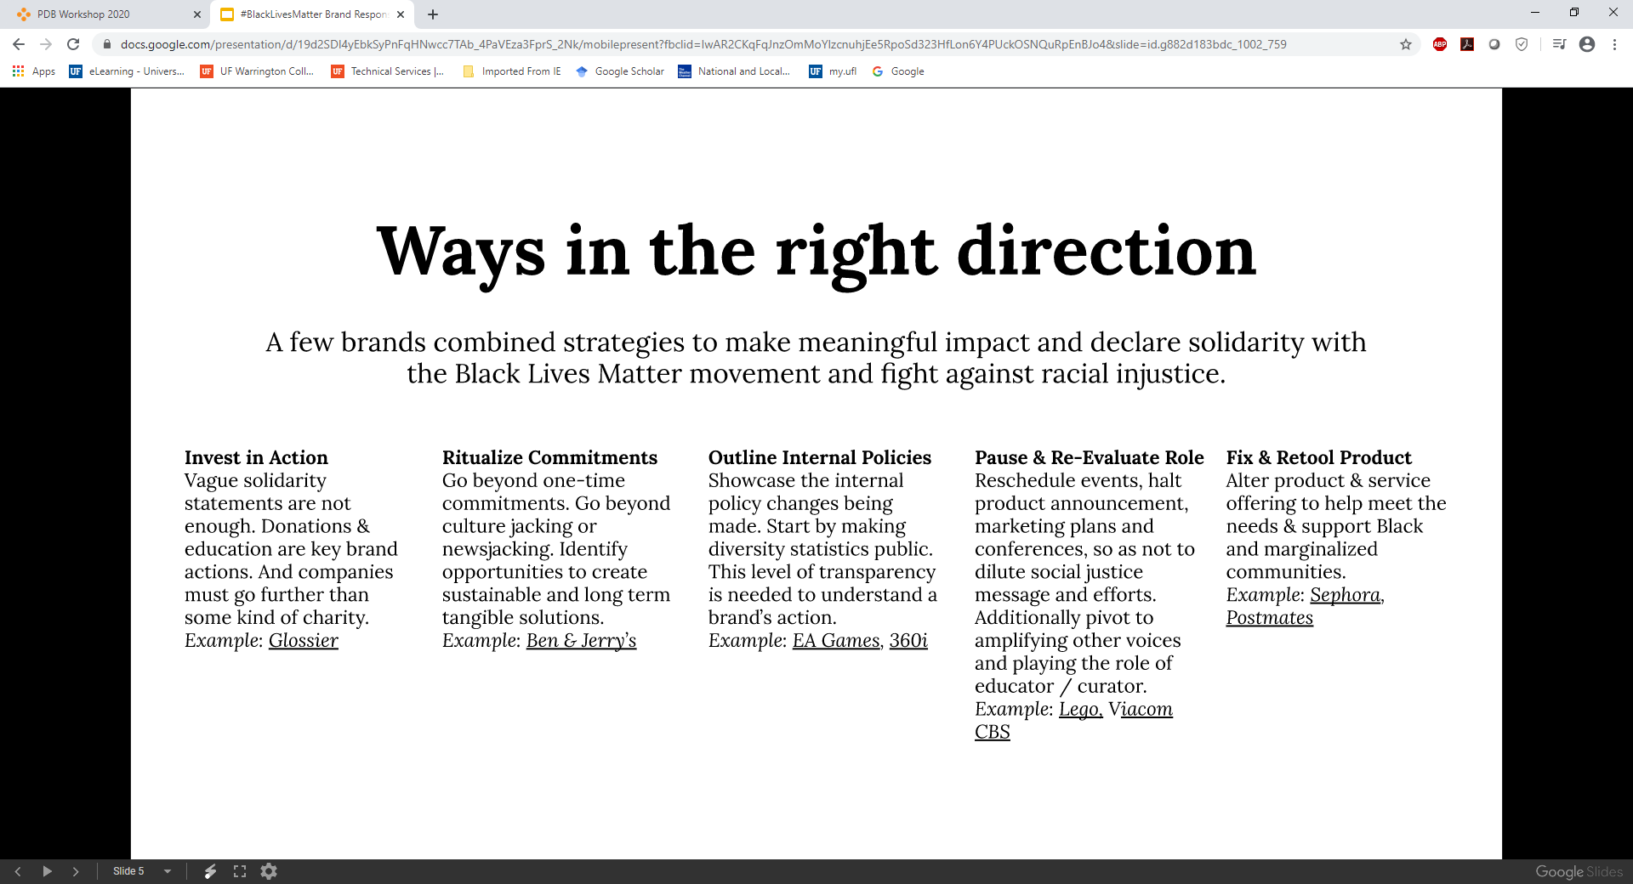
Best Practices

Slide 6
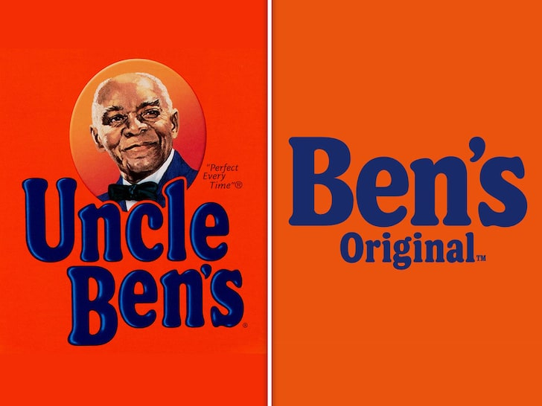
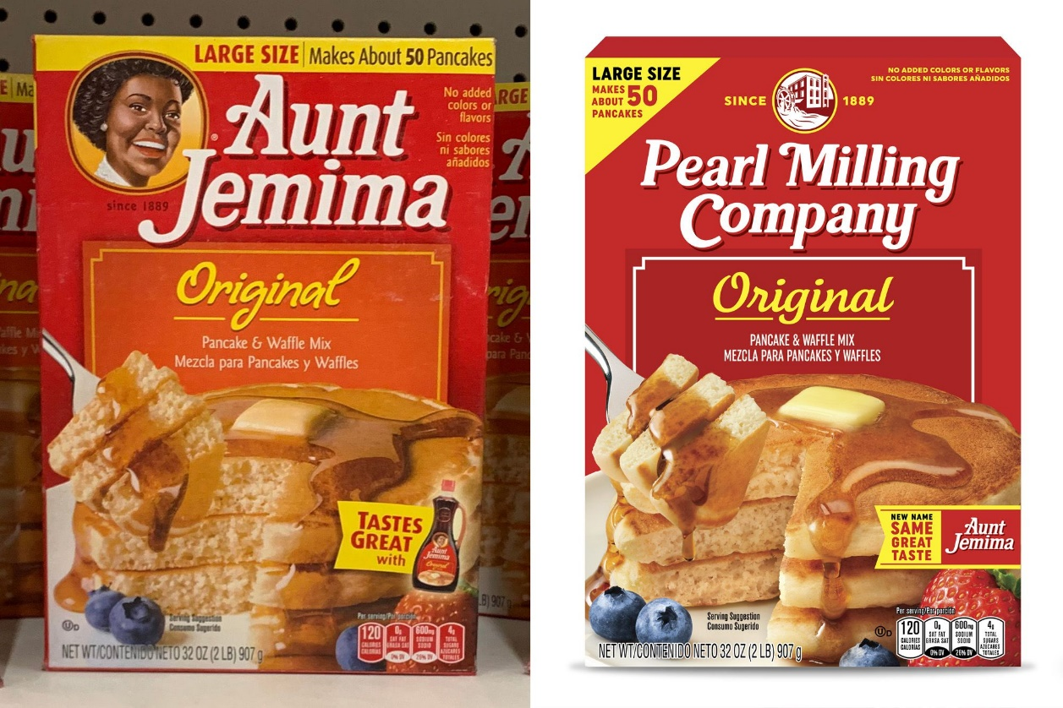
Brand Name Changes

Slide 7
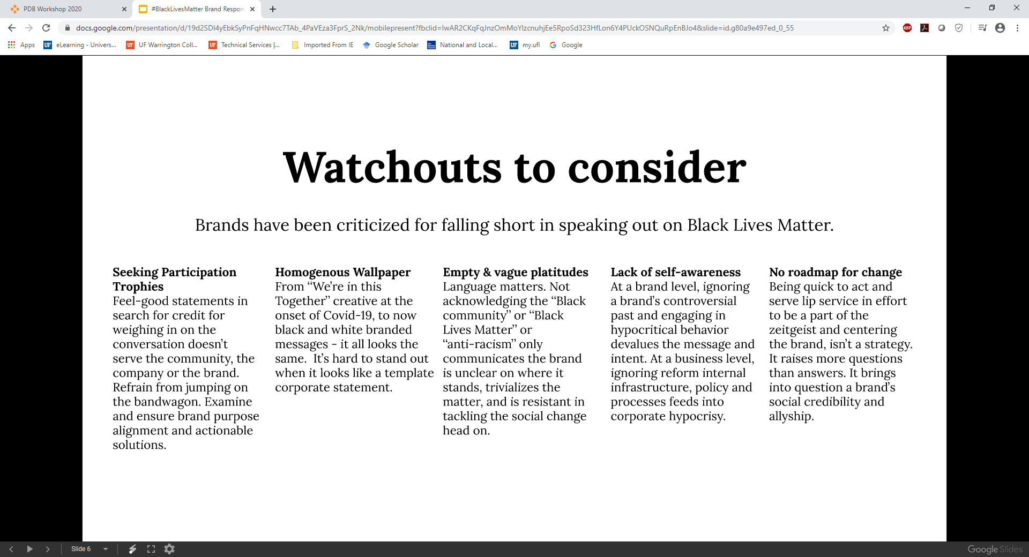
Pitfalls

Slide 8
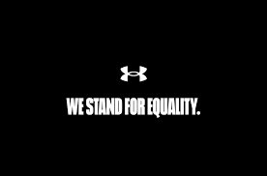


Company Instagram Posts Supporting #BLM

Slide 9
More than a #
Posting #BLM is not enough and may even backfire
Actions dominate messaging
Evidence of financial sacrifice to support the cause helps
Authenticity matters!

Slide 10
Conclusions
Did your firm respond to the #BLM movement?
If so, was the response genuine? Effective?
Did you alter your brand purchasing as a result of a brand’s #BLM response (or lack thereof)?

Slide 11
End of Lecture

